Slide 1
Numerical Methods for Science and Engineering
Chapter Two
Solutions to Linear System

Slide 2

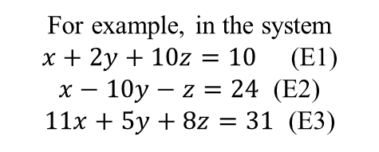






Solution of Linear System by Iterative Method
Objective: Solve the system of linear equations to find roots of the system.
An iterative method converges, for any choice of the first approximation, if every equation satisfies the condition that the magnitude of the coefficient of solving variable is greater than the sum of the absolute values of the coefficients of the other variables. A system satisfying this condition is called diagonally dominant. A linear system can always be reduced to diagonally dominant by elementary operations.
For example, in the system
$x+2y+10z=10$ (E1)
$x−10y−z=24$ (E2)
$11x+5y+8z=31$ (E3)
$\left|1\right|<\left|2\right|+|10|$
$\left|−10\right|<\left|1\right|+|−1|$
$\left|8\right|<\left|11\right|+|5|$
is not diagonally dominant. Rearrange as (E3)-(E1),(E2),(E1)
$10x+3y−2z=21$
$x−10y−z=24$
$x+2y+10z=10$
$\left|10\right|<\left|3\right|+|−2|$
$\left|−10\right|<\left|1\right|+|−1|$
$\left|10\right|<\left|1\right|+|5|$
Output : By applying Iterative Method, system of linear equations can be solved to find roots (approximately) of the system.

Slide 3
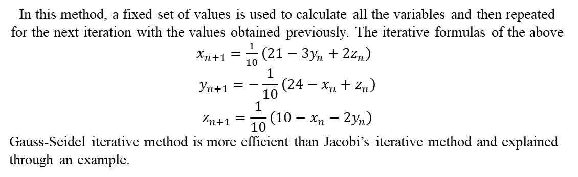
Jacobi Iterative Method:
In this method, a fixed set of values is used to calculate all the variables and then repeated for the next iteration with the values obtained previously. The iterative formulas of the above $x_{n+1}=\frac{1}{10}\left(21−3y_{n}+2z_{n}\right)$
$$y_{n+1}=−\frac{1}{10}\left(24−x_{n}+z_{n}\right)$$
$$z_{n+1}=\frac{1}{10}\left(10−x_{n}−2y_{n}\right)$$
Gauss-Seidel iterative method is more efficient than Jacobi’s iterative method and explained through an example.

Slide 4
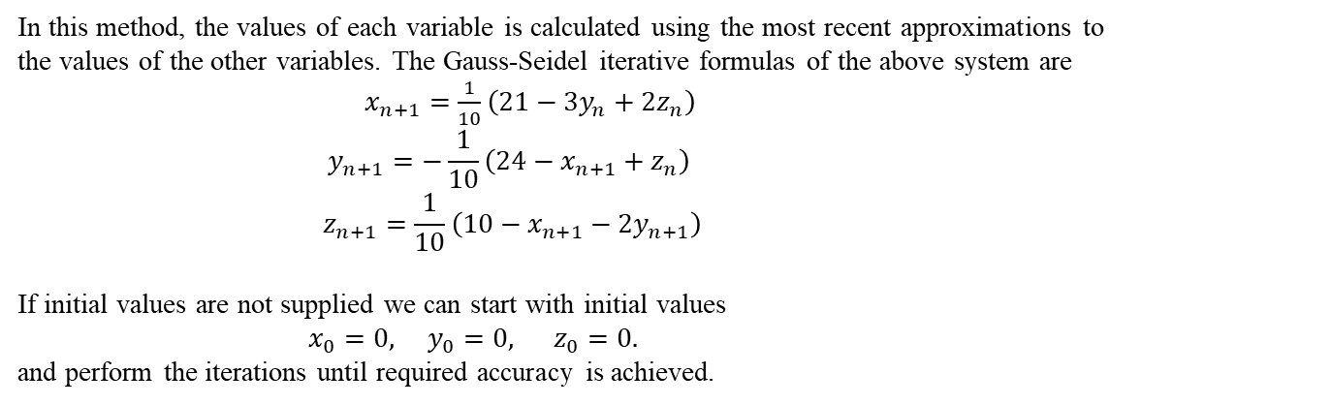
Gauss-Seidel Iterative Method
In this method, the values of each variable is calculated using the most recent approximations to the values of the other variables. The Gauss-Seidel iterative formulas of the above system are $x_{n+1}=\frac{1}{10}\left(21−3y_{n}+2z_{n}\right)$
$$y_{n+1}=−\frac{1}{10}\left(24−x_{n+1}+z_{n}\right)$$
$$z_{n+1}=\frac{1}{10}\left(10−x_{n+1}−2y_{n+1}\right)$$
If initial values are not supplied we can start with initial values
$x_{0}=0, y_{0}=0, z_{0}=0.$
and perform the iterations until required accuracy is achieved.

Slide 5
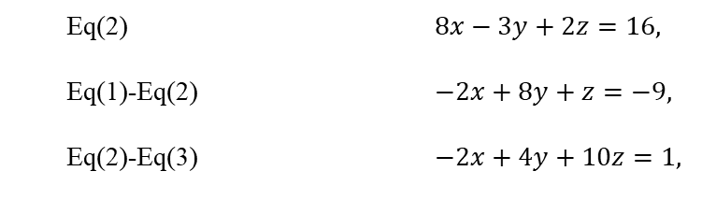

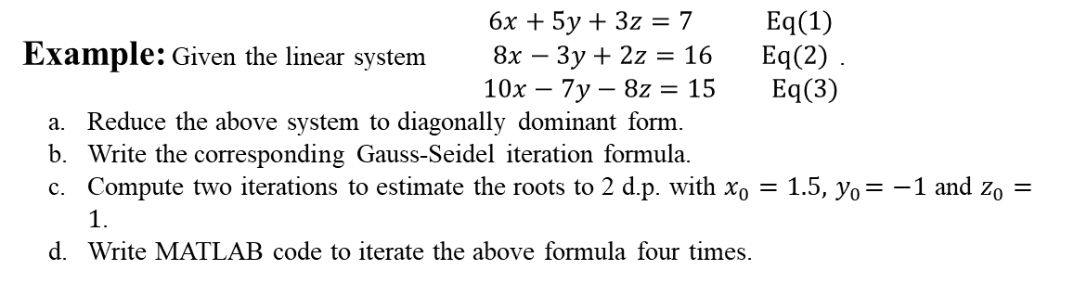



Example: Given the linear system $\begin{aligned}6x+5y+3z=7 Eq(1) \\ 8x−3y+2z=16 Eq(2) \\ 10x−7y−8z=15 Eq(3)\end{aligned}$.
a. Reduce the above system to diagonally dominant form.
b. Write the corresponding Gauss-Seidel iteration formula.
c. Compute two iterations to estimate the roots to 2 d.p. with $x_{0}=1.5, { y}_{0}=−1$ and $z_{0}=1$.
d. Write MATLAB code to iterate the above formula four times.
Solution:
Eq(2) $8x−3y+2z=16,$
Eq(1)-Eq(2) $−2x+8y+z=−9,$
Eq(2)-Eq(3) $−2x+4y+10z=1,$
$\left|8\right|<\left|−3\right|+|2|$
a.
$\left|8\right|<\left|−2\right|+|1|$
$\left|10\right|<\left|−2\right|+|4|$
b.
Gauss-Seidel formula $x_{n+1}=\frac{1}{8}\left[16+3y_{n}−2z_{n}\right]$
$y_{n+1}=\frac{1}{8}\left[−9+2x_{n+1}−z_{n}\right]$
$z_{n+1}=\frac{1}{10}\left[1+2x_{n+1}−4y_{n+1}\right]$

Slide 6
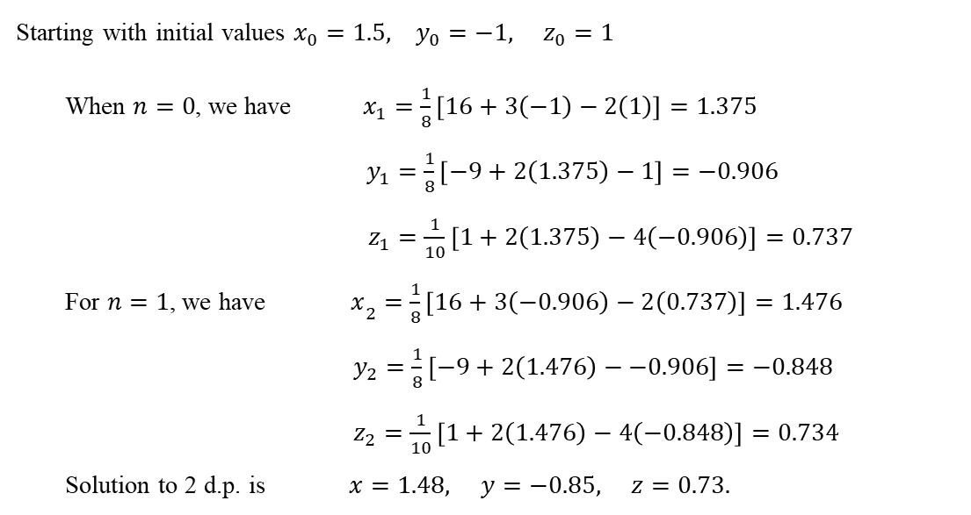
c.
Starting with initial values $x_{0}=1.5, y_{0}=−1, z_{0}=1$
When $n=0$, we have $x_{1}=\frac{1}{8}\left[16+3\left(−1\right)−2\left(1\right)\right]=1.375$
$y_{1}=\frac{1}{8}\left[−9+2\left(1.375\right)−1\right]=−0.906$
$z_{1}=\frac{1}{10}\left[1+2\left(1.375\right)−4\left(−0.906\right)\right]=0.737$
For $n=1$, we have $x­_{2}=\frac{1}{8}\left[16+3\left(−0.906\right)−2\left(0.737\right)\right]=1.476$
$y_{2}=\frac{1}{8}\left[−9+2\left(1.476\right)−−0.906\right]=−0.848$
$z_{2}=\frac{1}{10}\left[1+2\left(1.476\right)−4\left(−0.848\right)\right]=0.734$
Solution to 2 d.p. is $x=1.48, y=−0.85, z=0.73.$

Slide 7
d.
>> x(1)=1.5;
>> y(1)=-1;
>> z(1)=1;
>> iter(1)=0;
>> for n=1:4
iter(n+1)=n;
x(n+1)=(16+3*y(n)-2*z(n))/8;
y(n+1)=(-9+2*x(n+1)-z(n))/8;
z(n+1)=(1+2*x(n+1)-4*y(n+1))/10;
end
>> Solution = [iter',x',y',z’]
Solution =
0 1.5000 -1.0000 1.0000
1.0000 1.3750 -0.9063 0.7375
2.0000 1.4758 -0.8482 0.7345
3.0000 1.4983 -0.8422 0.7366
4.0000 1.5000 -0.8421 0.7368

Slide 8
SAMPLE MCQ
If every equation satisfies the condition that the magnitude of the coefficient of solving variable is greater than the sum of the absolute values of the coefficients of the other variables. A system satisfying this condition is called
Diagonally Dominant
Iterative equation
Maximum value eqation
None
2. In Gauss-Seidel Iterative Method the values of each variable is calculated using which approximations to the values of the other variables
Most recent
old
Both
None
3. Which method is more convenient?
Gauss-Seidal Method
Gauss Jacobi method
Both
None

Slide 9
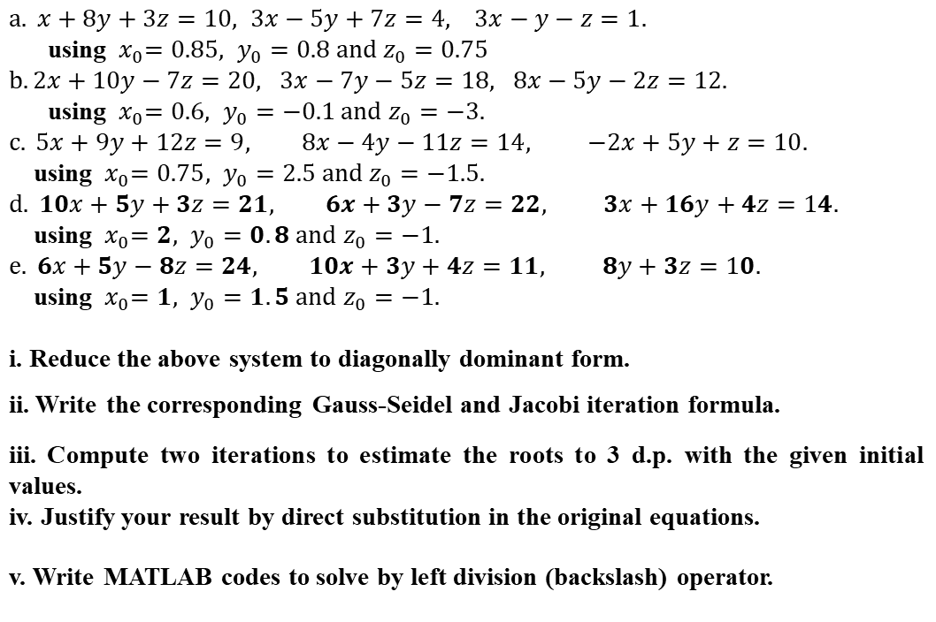
Exercise
1.
$a. x+8y+3z=10, 3x−5y+7z=4, 3x−y−z=1.$ using ${ x}_{0}=0.85, y_{0}=0.8 and z_{0}=0.75$ $b. 2x+10y−7z=20, 3x−7y−5z=18, 8x−5y−2z=12.$ using ${ x}_{0}=0.6, y_{0}=−0.1 and{ z}_{0}=−3.$ $$c. 5x+9y+12z=9, 8x−4y−11z=14, −2x+5y+z=10.$$ using ${ x}_{0}=0.75, y_{0}=2.5 and{ z}_{0}=−1.5.$ $$d. 10x+5y+3z=21, 6x+3y−7z=22, 3x+16y+4z=14.$$ using ${ x}_{0}=2, y_{0}=0.8 and{ z}_{0}=−1.$ $$e. 6x+5y−8z=24, 10x+3y+4z=11, 8y+3z=10.$$ using ${ x}_{0}=1, y_{0}=1.5 and{ z}_{0}=−1.$
i. Reduce the above system to diagonally dominant form.
ii. Write the corresponding Gauss-Seidel and Jacobi iteration formula.
iii. Compute two iterations to estimate the roots to 3 d.p. with the given initial values.
iv. Justify your result by direct substitution in the original equations.
v. Write MATLAB codes to solve by left division (backslash) operator.

Slide 10
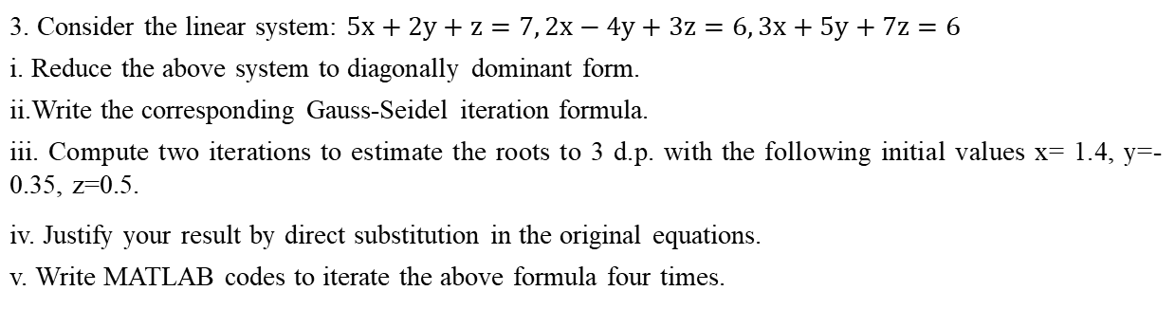
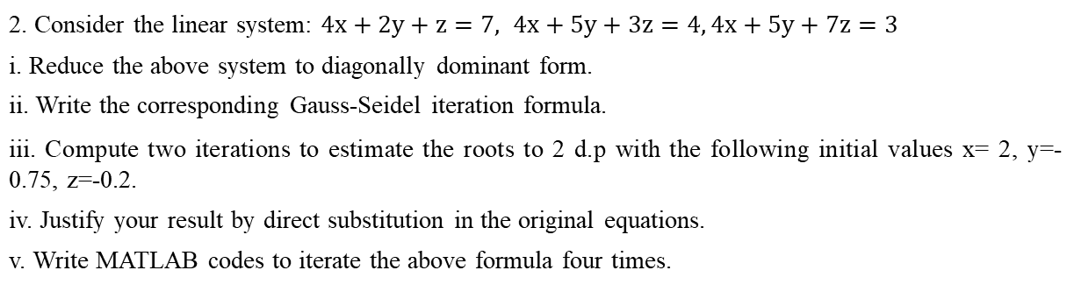
2. Consider the linear system: $4x+2y+z=7, 4x+5y+3z=4, 4x+5y+7z=3$
i. Reduce the above system to diagonally dominant form.
ii. Write the corresponding Gauss-Seidel iteration formula.
iii. Compute two iterations to estimate the roots to 2 d.p with the following initial values x= 2, y=-0.75, z=-0.2.
iv. Justify your result by direct substitution in the original equations.
v. Write MATLAB codes to iterate the above formula four times.
3. Consider the linear system: $5x+2y+z=7, 2x−4y+3z=6, 3x+5y+7z=6$
i. Reduce the above system to diagonally dominant form.
ii.Write the corresponding Gauss-Seidel iteration formula.
iii. Compute two iterations to estimate the roots to 3 d.p. with the following initial values x= 1.4, y=-0.35, z=0.5.
iv. Justify your result by direct substitution in the original equations.
v. Write MATLAB codes to iterate the above formula four times.

